Slide 1
ADC and Single Tone Vivado BD Breakdown

Slide 2
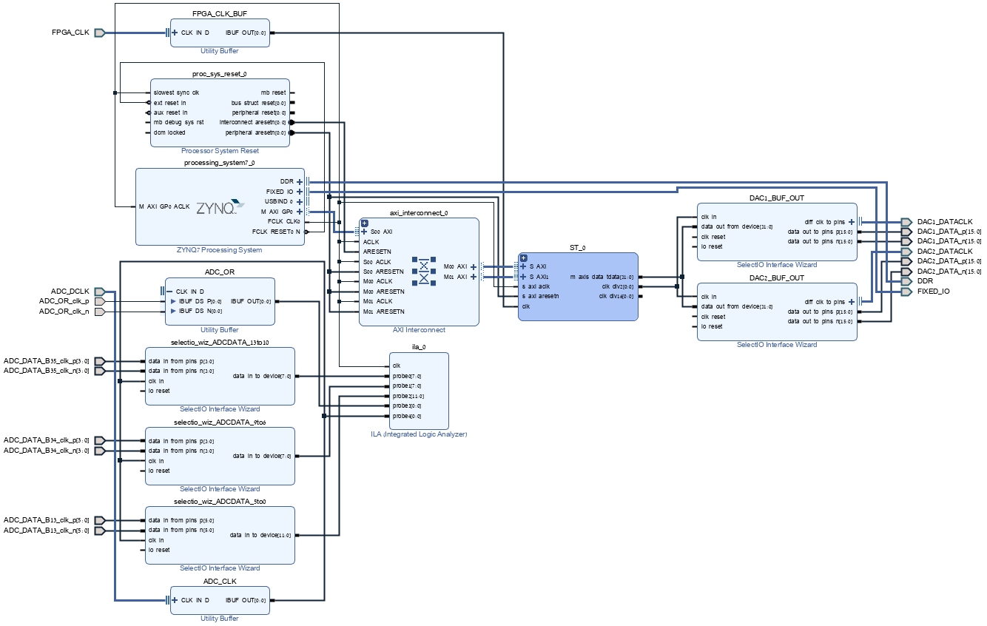

Slide 3
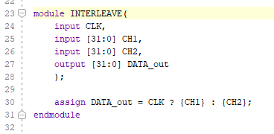
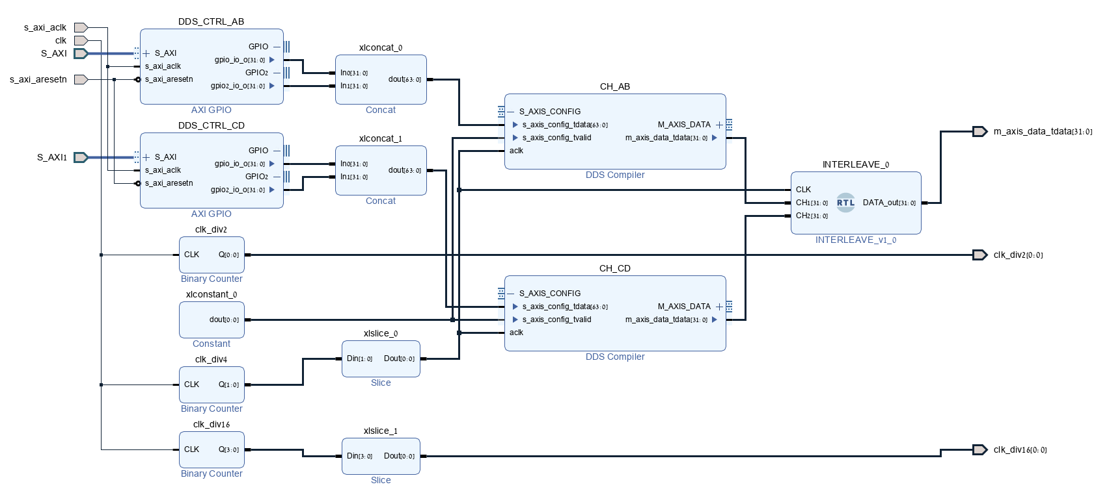
AXI Controls for the ST. two channels, all outputs, 32b output
FPGA_CLK 250MHz

Slide 4
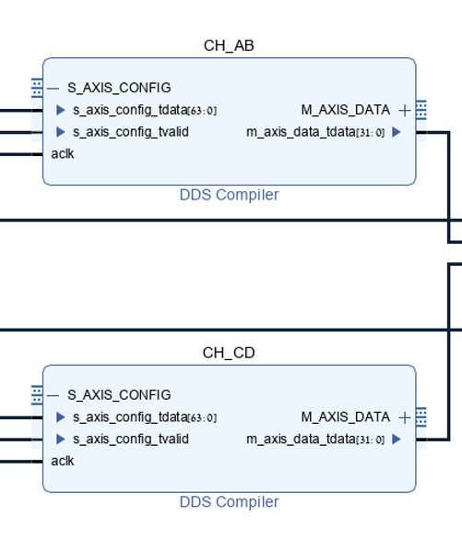
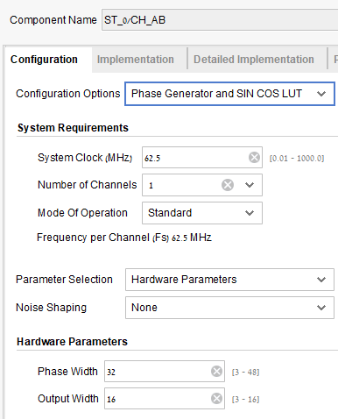
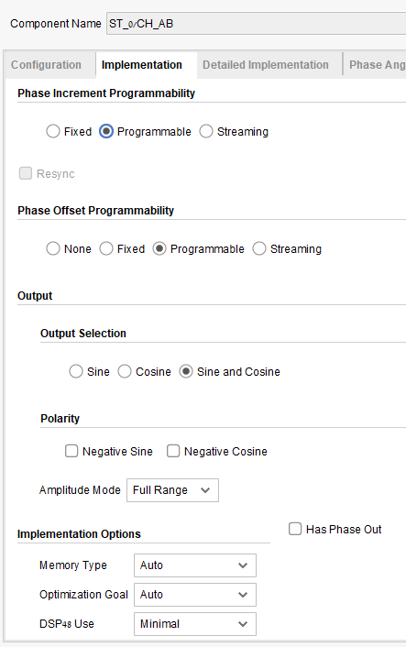
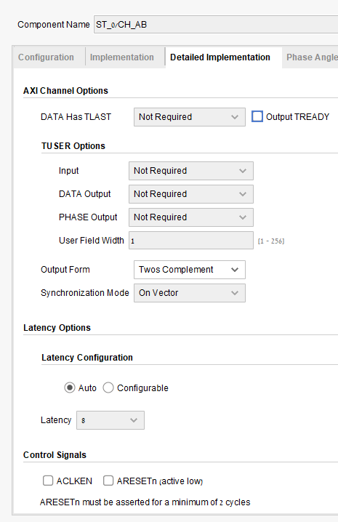

Slide 5
DATA INPUTS TO ADC.
SHARED WITH MT PROFILE_ADDR AND AM_onoff AND WILL NOT WORK IN PARALLEL.
ADC_DATA BITS ARE SCATTERED IN ALL BANKS SO THEY ARE DEVIDED HERE AS WELL
ADC OUPUTS IN DDR, CH1 RISING_EDGE CH2 FALLING_EDGE

